Slide 1
Cub Scout Bobcat Requirements

Slide 2
Requirements
Say the Cub Scout motto. Tell what it means.
Show the Cub Scout Sign. Tell what it means.
Show the Cub Scout salute. Tell what it means.
Show the Cub Scout handshake. Tell what it means.
Learn and say the Scout Oath
Learn and say the Scout Law
With parents complete exercises in pamphlet How to Protect Your Children from Abuse: A Parent’s Guide – Bobcat Requirements

Slide 3
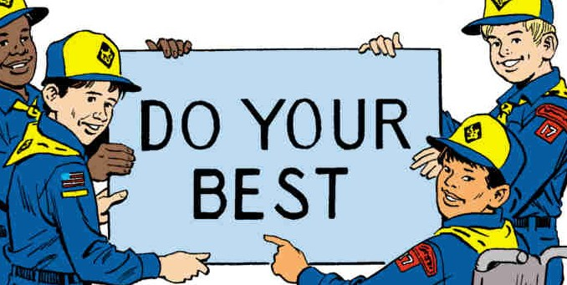
Cub Scout Motto
“Do Your Best”
What do you think do your best means?

Slide 4
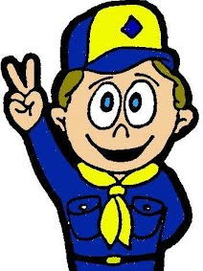
Cub Scout Sign
2 fingers raised in the air
Stands for the Scout Oath and the Scout Law
Look’s like wolf’s ears ready to listen to Akela
  Akela is based off Rudyard Kipling’s “The Jungle Book”
  Symbol of wisdom, authority, and leadership
  Akela is anyone who acts as a leader to a Scout (Cubmaster, Den Leader, parent, teacher)
Give the Cub Scout Sign when you say the Scout Oath or Scout Law

Slide 5

Cub Scout Salute
2 fingers on right hand pointing out straight and close together
Touching eyebrow or brim of hat
A salute is a way of showing respect
  When saluting a leader (either adult or scout) you show him or her that you respect their position
  When saluting the flag you show that you are proud of your country
Should only salute if in uniform

Slide 6
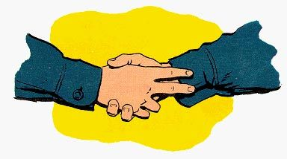
Cub Scout Handshake
Using right hand place first two fingers along inside of other leader or scouts wrists
This means that you help each other remember and obey the Scout Oath and Scout Law

Slide 7

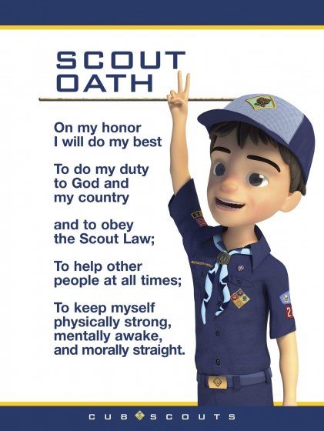
Scout Oath
A solemn, formal declaration or promise to fulfill a pledge, often calling on God as witness
Said before every opening flag ceremony at Den and Pack meetings
https://boyscouttrail.com/boy-scouts/scout-oath.asp#:~:text=Oath%3A%20A%20solemn%2C%20formal%20declaration,mentally%20awake%2C%20and%20morally%20straight.

Slide 8
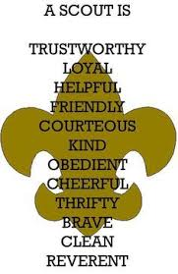
Scout Law
12 points to Scout Law
Characteristics that every scout should follow
http://usscouts.org/advance/boyscout/bslaw.asp

Slide 9
Learning Recap
Cub Scout Motto – “Do Your Best”
Cub Scout Sign
Cub Scout Salute
Cub Scout Handshake
Scout Oath
Scout Law
Complete exercises in pamphlet with your parents

